Slide 1
Small Talk
Constantin Kwiatkowski

Slide 2
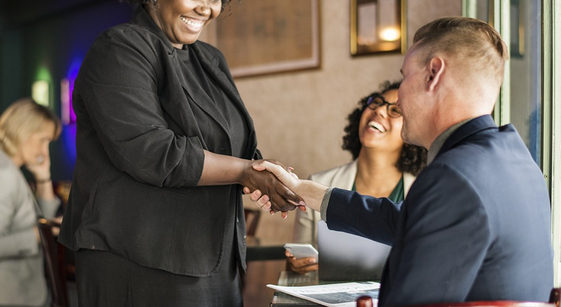
Why do people make small talk?
Socializing is very importment for sales people
First impression counts
Crafting a pleasant atmosphere is good for business

Slide 3
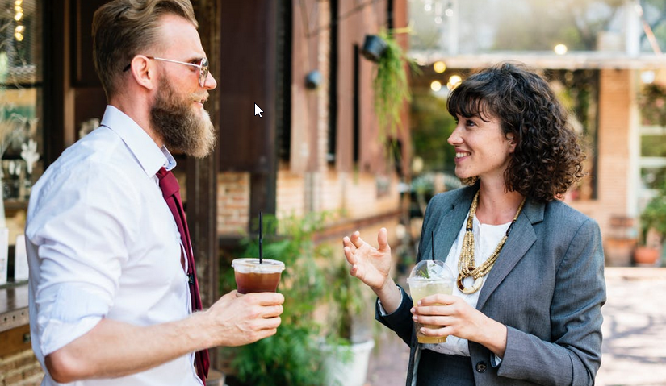
How to make small talk?
open-ended questions
  generate an interesting, dynamic conversation and encourage the person you’re speaking with to open up
practice active listening
  you’ll forge much stronger connections if you pay attention. The other person will notice how engaged you seem.
  it’s much easier to ask relevant questions and remember details to bring up later
Speak kindly
  use anecdotes and choose wisely your words
show your enthusiasm/motivation
  conversations are opportunities to learn more about other people

Slide 4

sports news
weather
Safe topics
entertainment news
current events

Slide 5
religion
politics
Unsafe topics
personal
information
war

Slide 6
Conclusions
Practice making small talk
Use open-ended questions,
active listening, …
Always use safe topics such as sports, weather, events, ...
Avoid unsafe topics such as war, religion, politics, …
Better business deals
Improve the first impression
Low risk of conflicts
High risk of conflicts

Slide 7
Thank You
Constantin Kwiatkowski

